Slide 1


MATLAB & Simulink workshop
Made by: Youssef Ahmed

Slide 2

Session 5
Data Fitting & Signals processing

Slide 3

Workshop timeline

Slide 4

Part 1: Data fitting

Slide 5
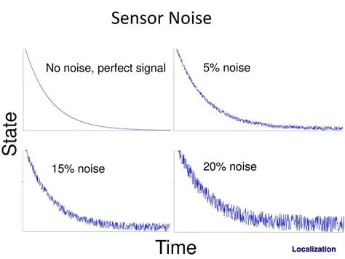
Data fitting
Why we need such things
Answer can be summarized on one word:
DATA NOISE

Slide 6
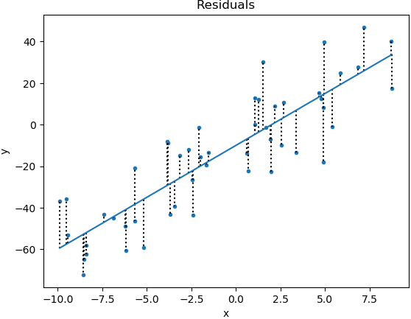
Data fitting
How to perform data fitting
We must assume we know system behavior (equation).
Then we try to minimize the error of equation vs real data
But what if we don’t know system equation ?
Y=mX+c

Slide 7
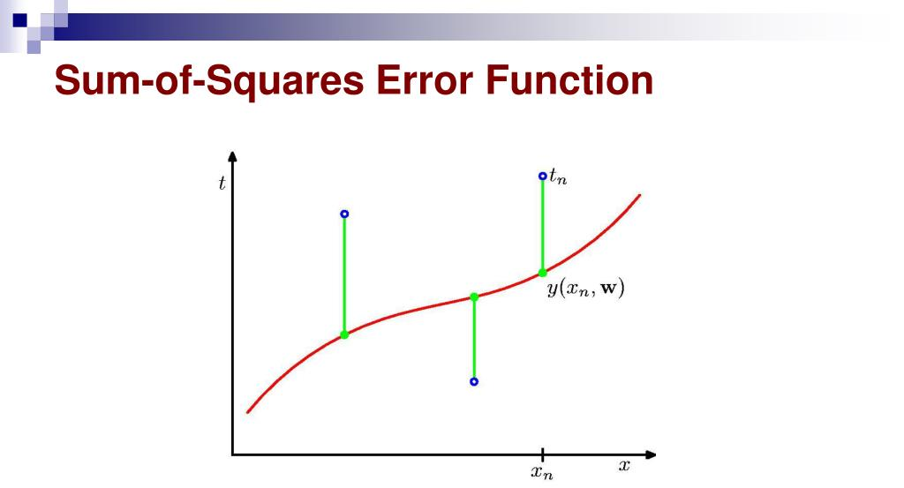
Data fitting
How can we measure the goodness of a fit?
There are a lot of parameters that can be used, the most important are:
Sum of square error
Root mean square error

Slide 8

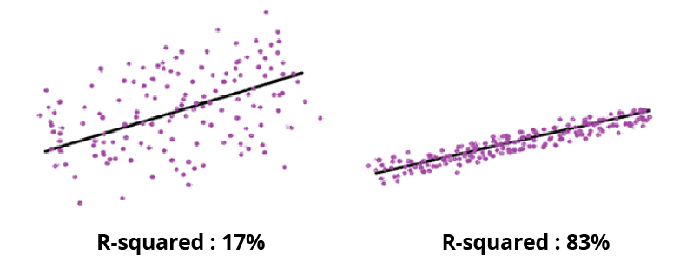
Data fitting
How can we measure the goodness of a fit?
There are a lot of parameters that can be used, the most important are:
3) R-squared

Slide 9
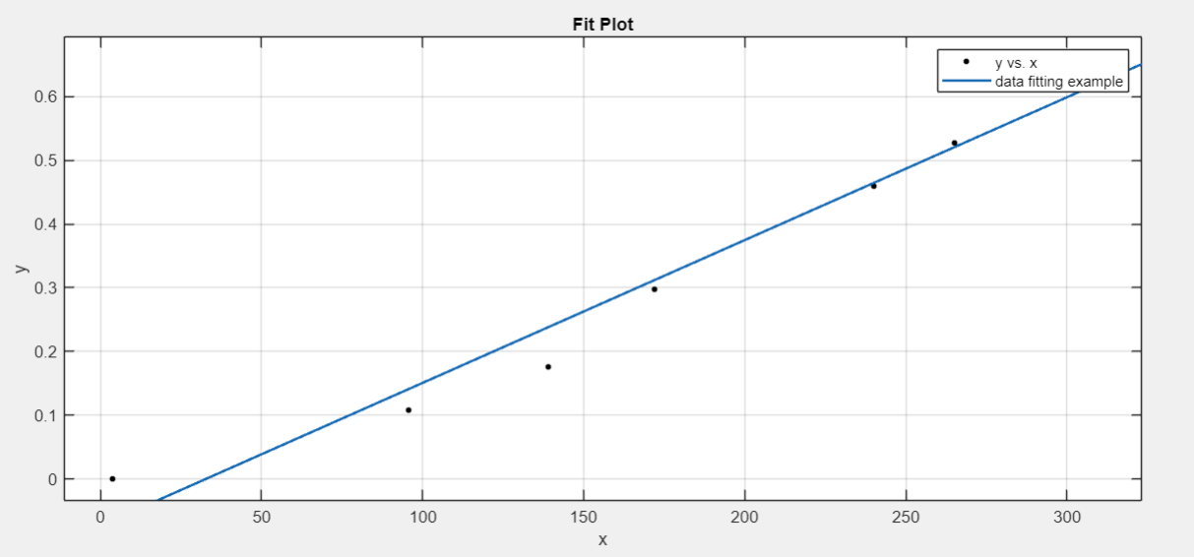
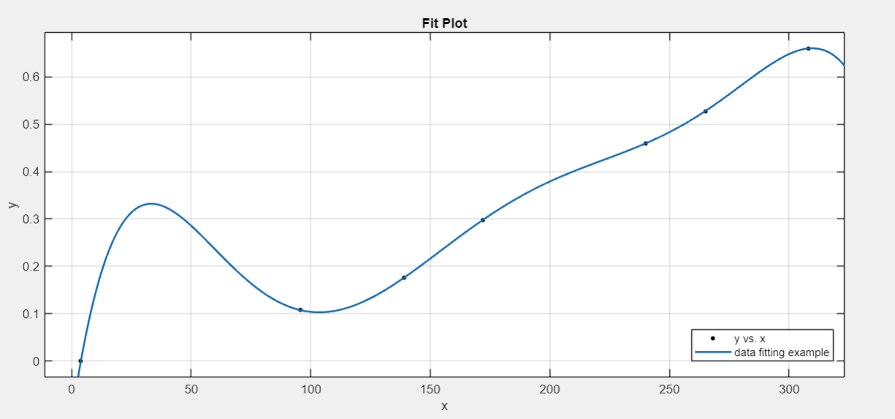
Data fitting
Overfitting problem
Which one is better and why?
(a)
(b)
(a) Is much better, but why?

Slide 10

Data fitting
Validation data
It is the answer to unknown system equation and overfitting problem.

Slide 11

MATLAB time!
Now let’s see them live in MATLAB

Slide 12

Part 2: Signals processing

Slide 13

Signals processing
What we will cover
Signals processing is a vast topic, we will cover the main step only which is: DATA FILTERING

Slide 14
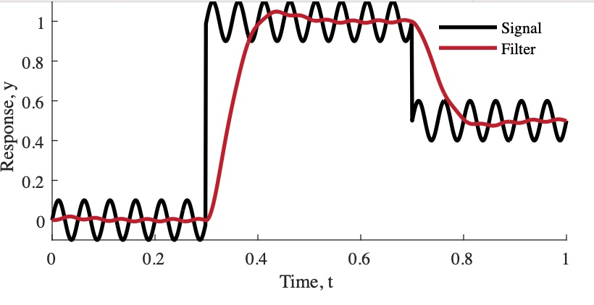
Signals processing
Data filtering
What is data filtering?

Slide 15
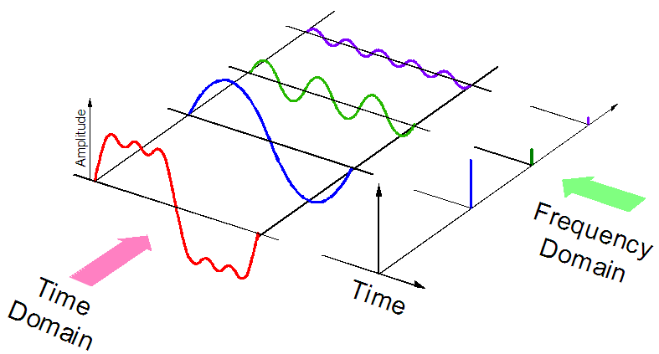
Signals processing
Time vs frequency domain and Fourier series and transform

Slide 16
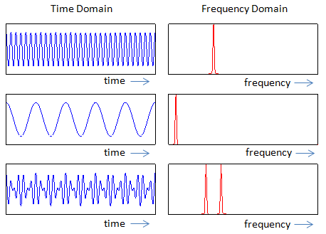
Signals processing
How would that help?

Slide 17
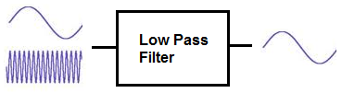
Signals processing
Low pass filter

Slide 18
MATLAB time!
Now let’s see what we covered so far in MATLAB

Slide 19
Task
1-Overview
You are required to load the data from a given file, then pre-process the data then perform data fitting to find the original function equation and parameters.
2-Data loading
The data will be provided through a (.csv) file, with two nameless columns, you are required through data importing app in MATLAB to give a name to each column and then importing it as a table or matrix, generating a data importing script in the process

Slide 20
Task
3-Data filtering
The data contains two modes of noise, random noise, and a constant frequency noise, you are required to perform FFT to identify noise frequency then apply a low pass filter to eject the noise.
4-Data fitting
After removing the constant frequency noise, you are required to identify the equation and parameters representing the data using curve fitter app, divide the data into fitting (training) and validation, with a ratio of 30% of data used for validation

Slide 21
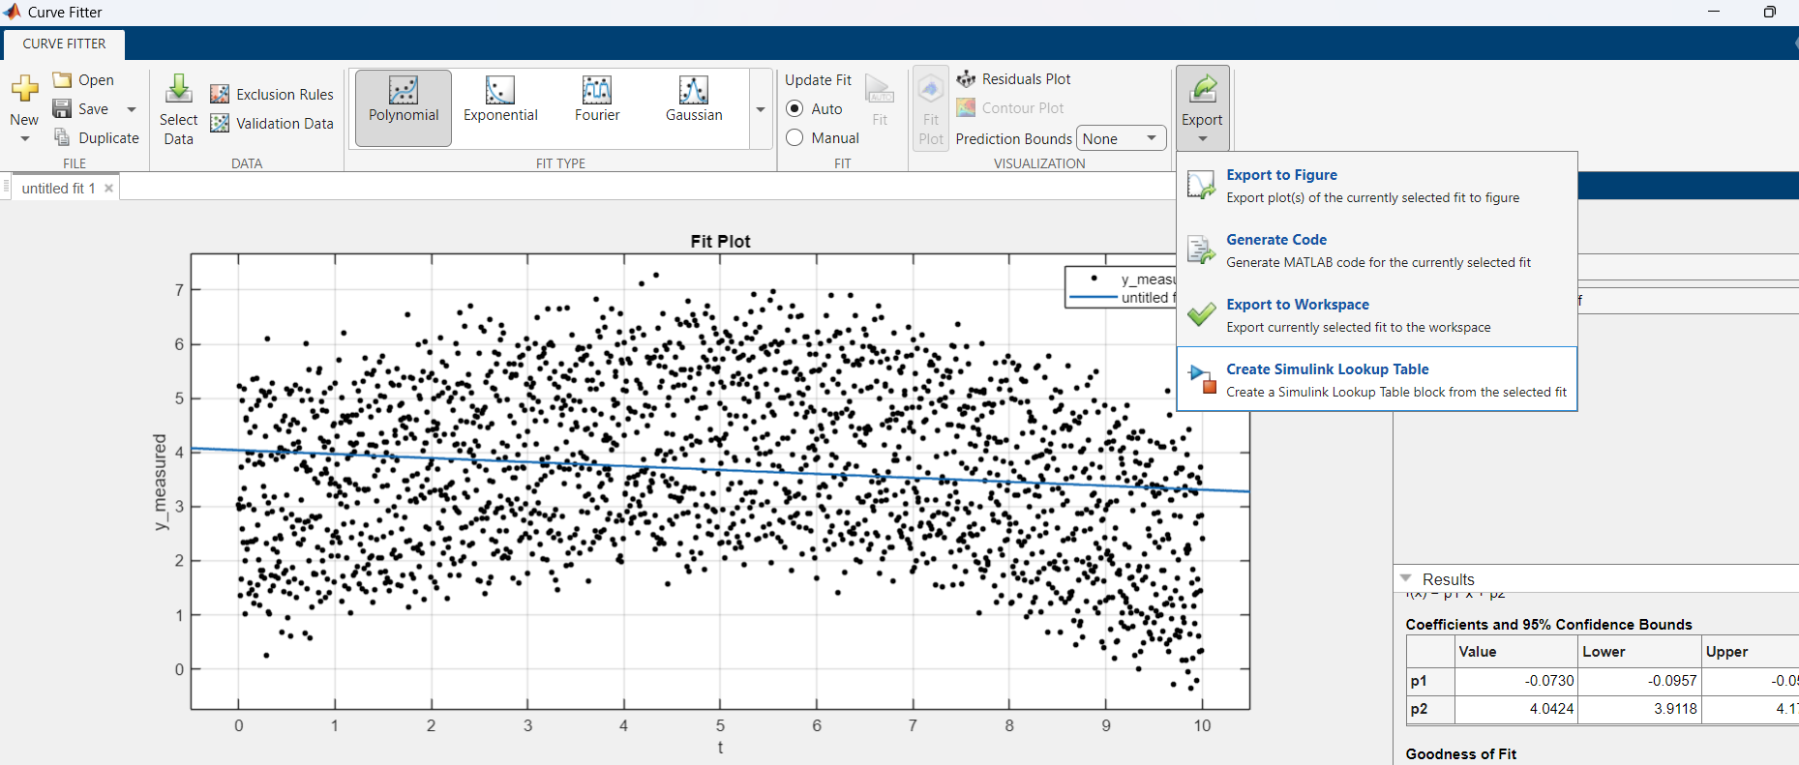
Task
5-Exporting results
After successfully fitting the curve use export to MATLAB option and save the three variables generated by the app in a (.mat) file :
-output
-goodness
-fittedmodel
1
2

Slide 22
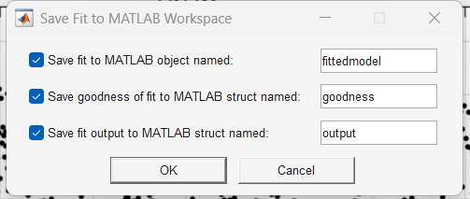
Task
5-Exporting results
Make sure all checkboxes for variables needed are checked

Slide 23
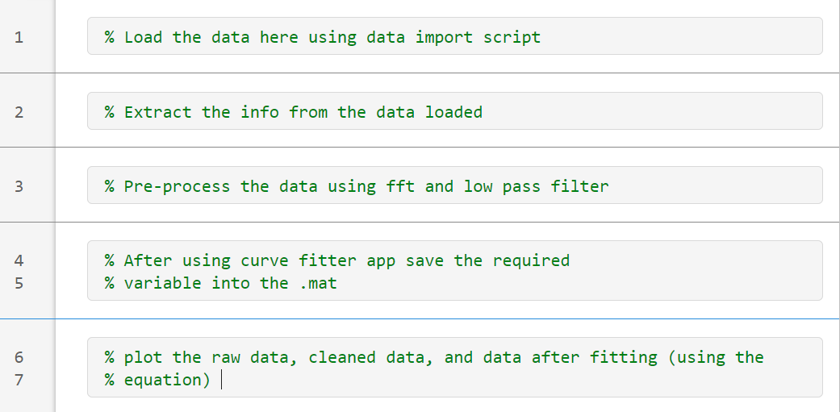
Task
6-Code organization
Do all the work in a live a script, you can use the following format for organization

Slide 24
Task
7-Summary submission
To summarize you are required to submit a (.zip) file containing:
The live script (.mlx)
Data importing script (.m)
Workspace file (.mat)

Slide 25
Thank you!

